Slide 1
BERT
IAC Deep Learning Course

Slide 2
BERT
Paper
Source Code
PyTorch implementation
BERT Fine Tuning for Cloud TPU
BERT’s Impact on Google Search
ELECTRA
ELECTRA Repo

Slide 3
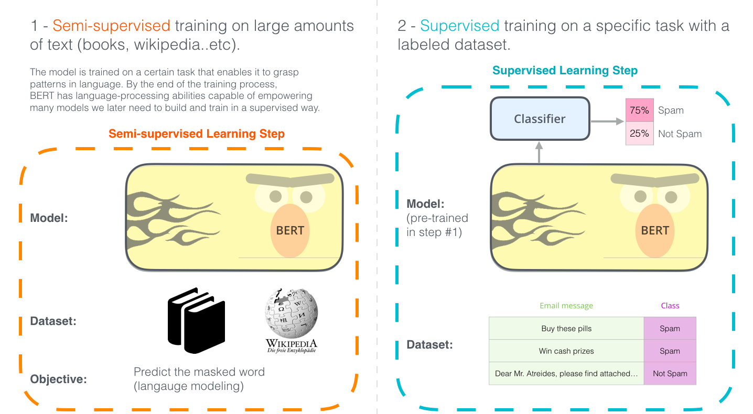
BERT: Another Revolution in NLP

Slide 4
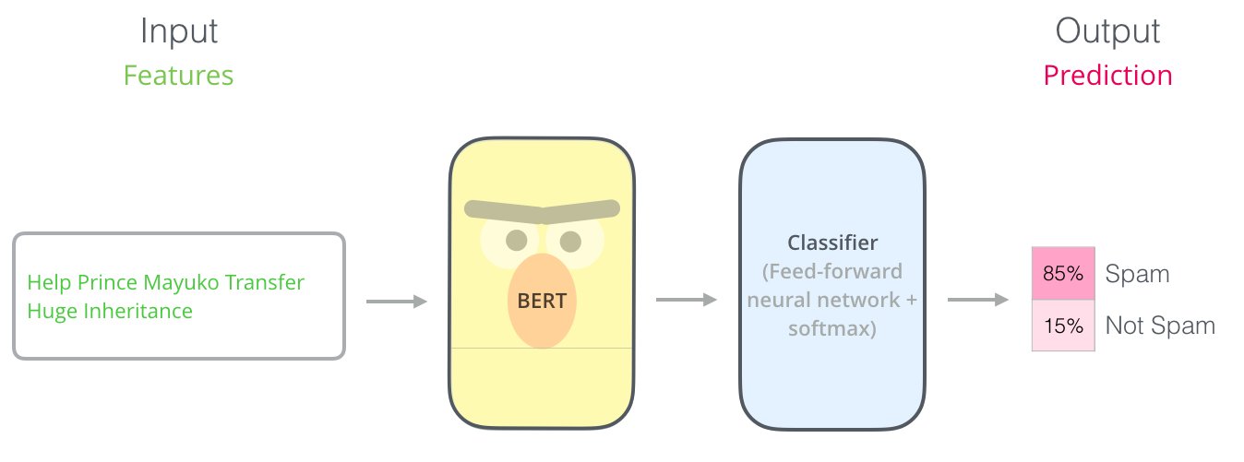
Simplest use of BERT is Classification

Slide 5
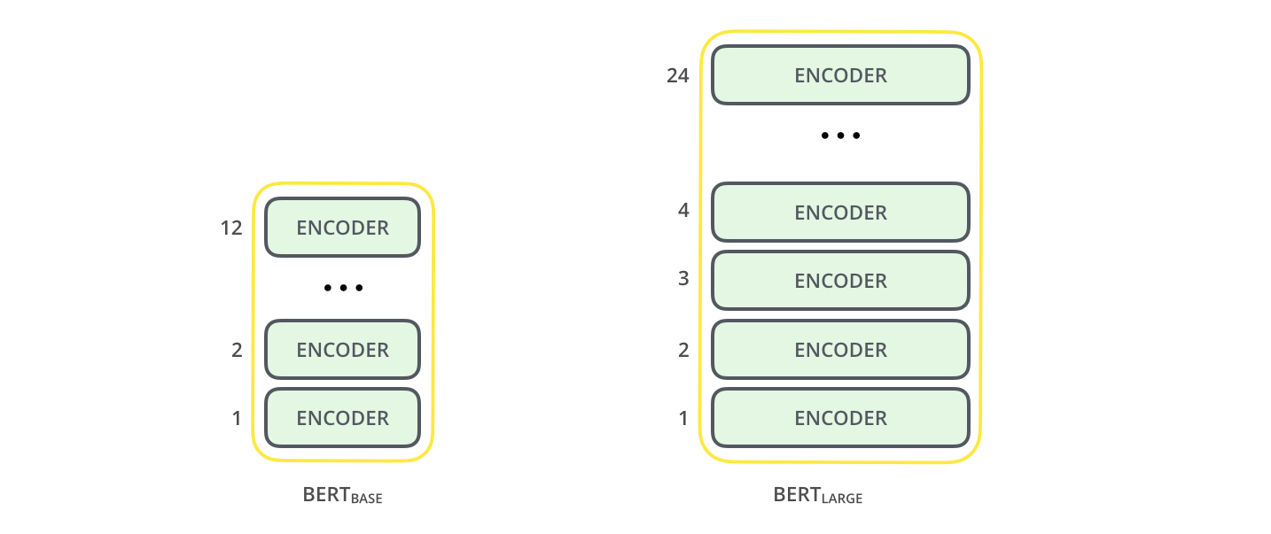
Built on Transformers (Encoders)

Slide 6
Basics
Both BERT model sizes have a large number of encoder layers (which the paper calls Transformer Blocks) – twelve for the Base version, and twenty four for the Large version.
These also have larger feedforward-networks (768 and 1024 hidden units respectively),
And more attention heads (12 and 16 respectively) than the default configuration in the reference implementation of the Transformer in the initial paper (6 encoder layers, 512 hidden units, and 8 attention heads).

Slide 7
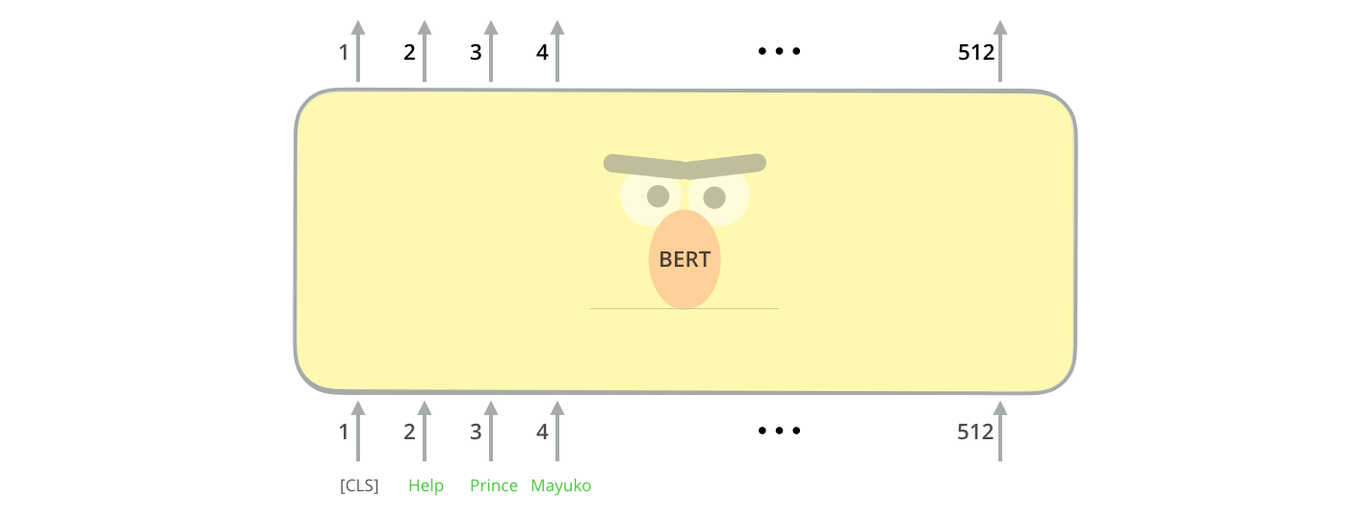
Architecture

Slide 8
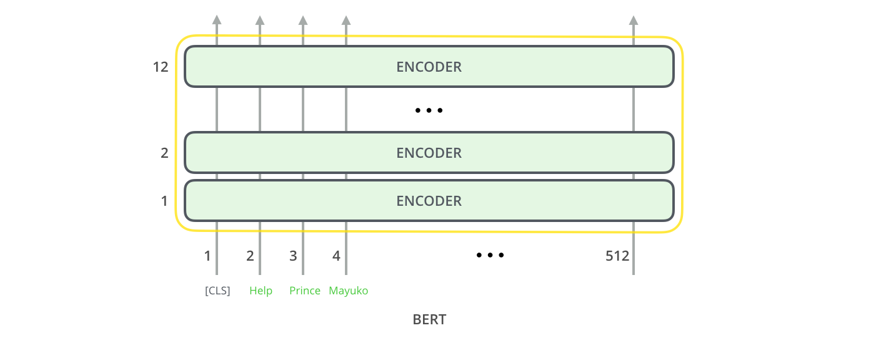
Architecture

Slide 9
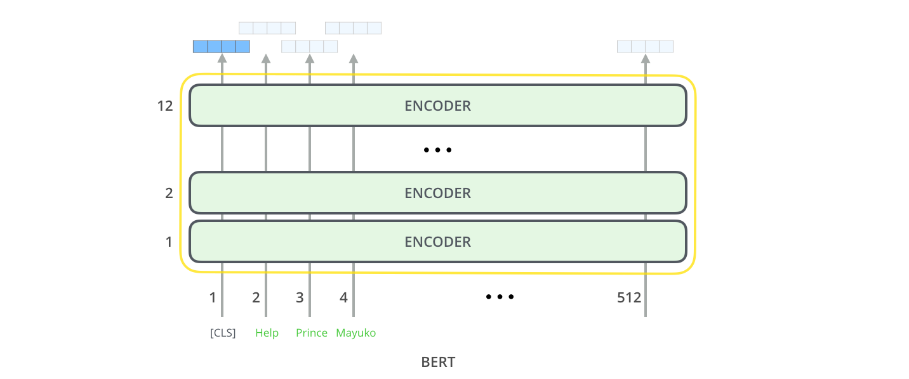
Architecture (Output size is different than Transformer)

Slide 10
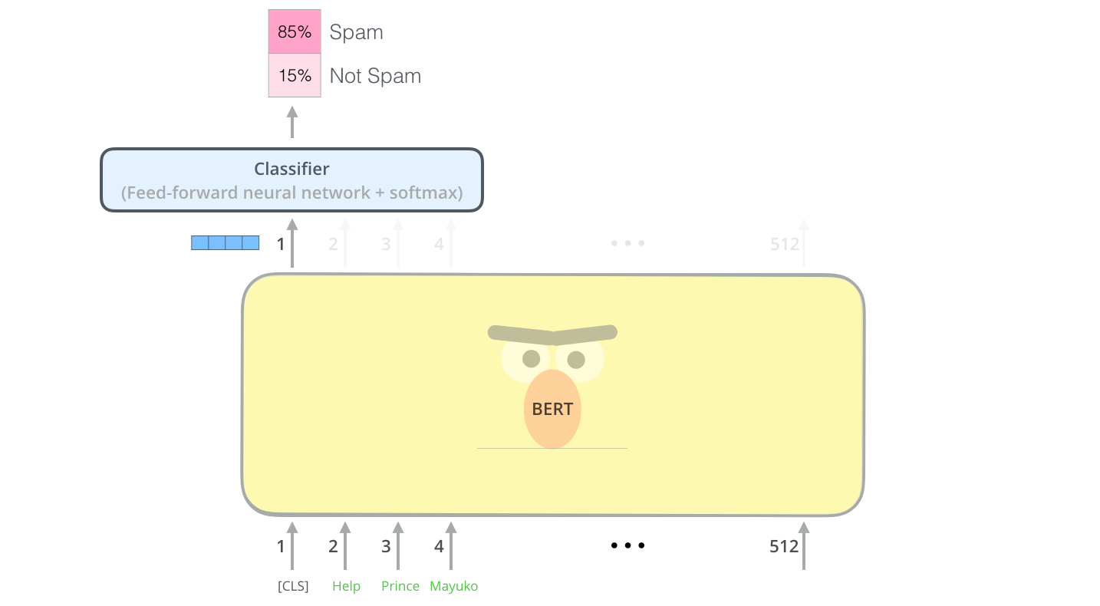
Architecture

Slide 11
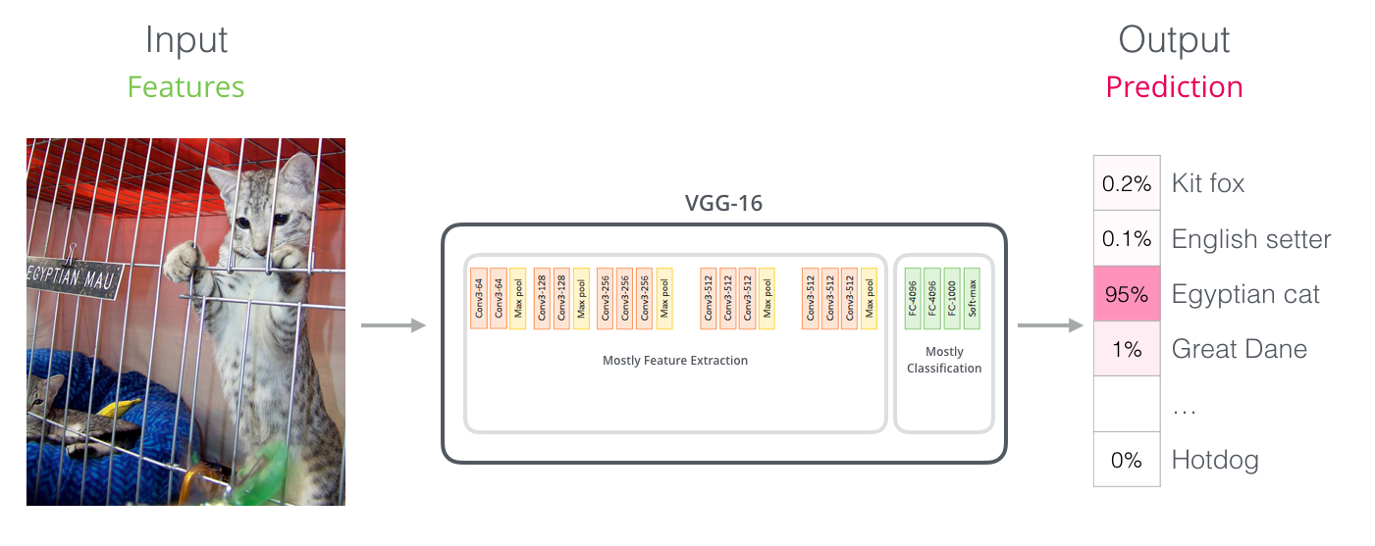
Comparable with Vision Model VGGNet

Slide 12
So, What’s the major change?
No more Word2Vec and Glove embedding
These embeddings are not contextualized

Slide 13

ElMo

Slide 14
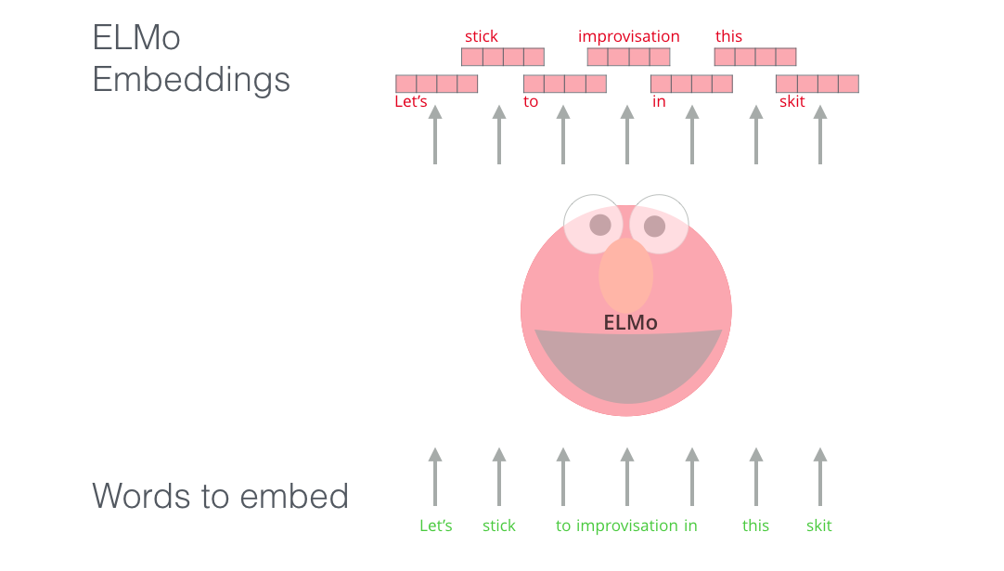
ElMo (Bi-LSTM)

Slide 15
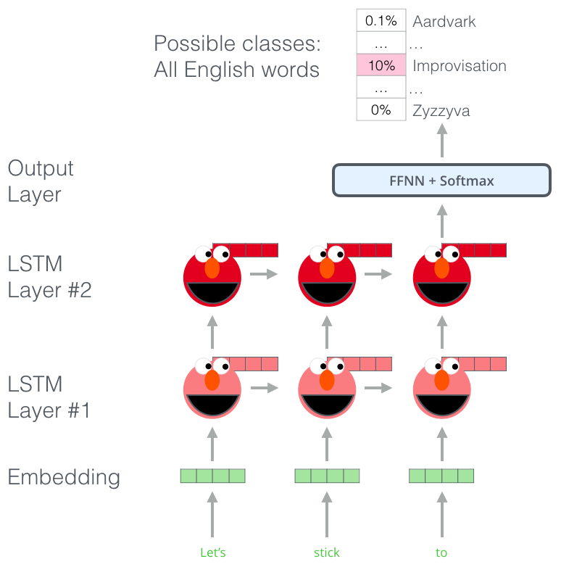
ELMo

Slide 16
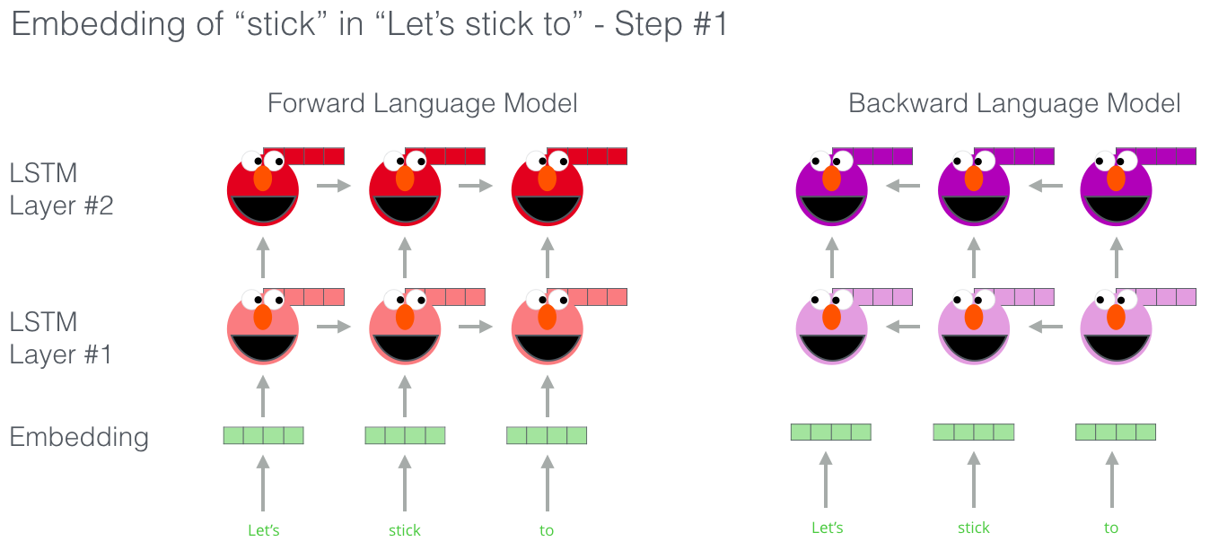
ELMo

Slide 17
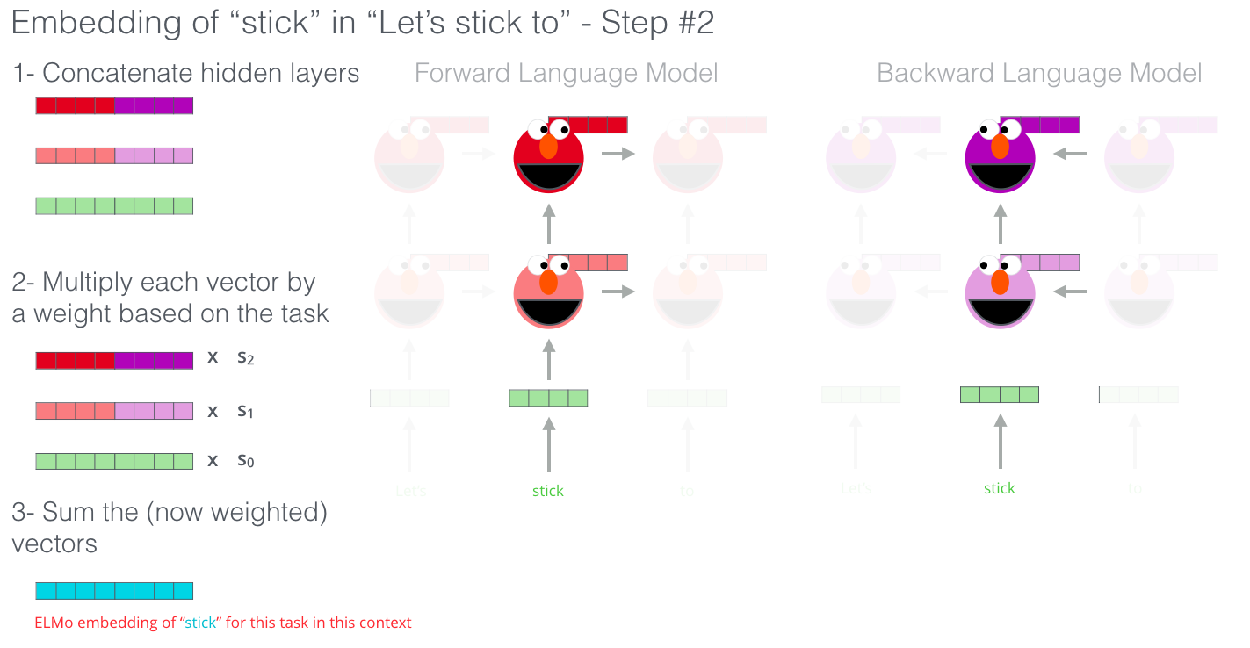
ELMo

Slide 18
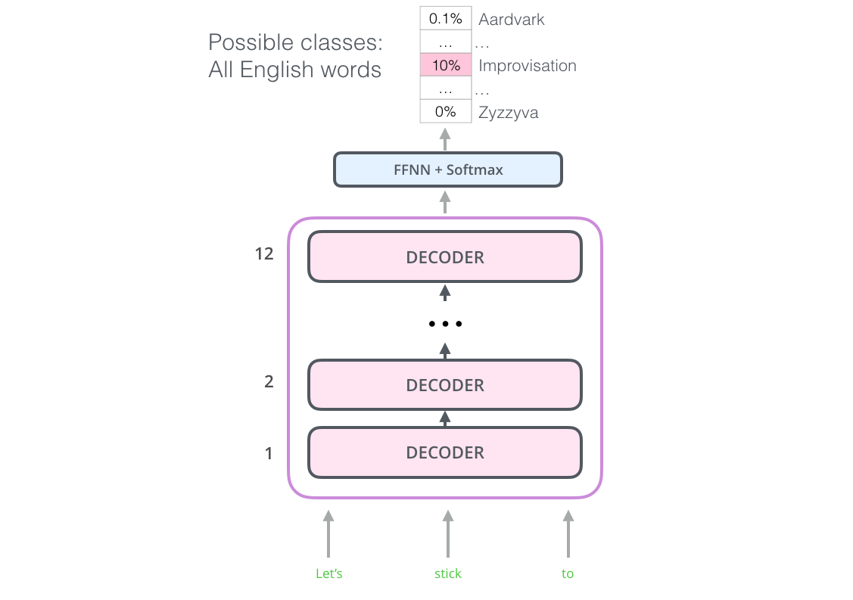
The Open AI Transformer

Slide 19
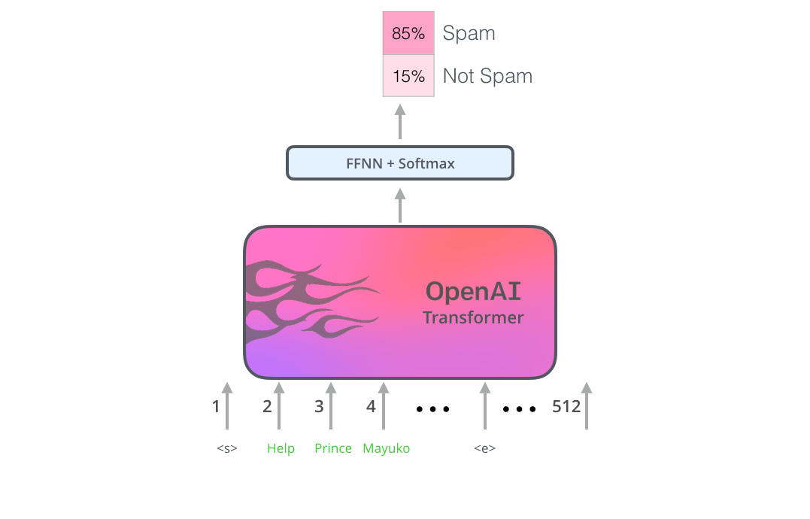
The Open AI Transformer

Slide 20
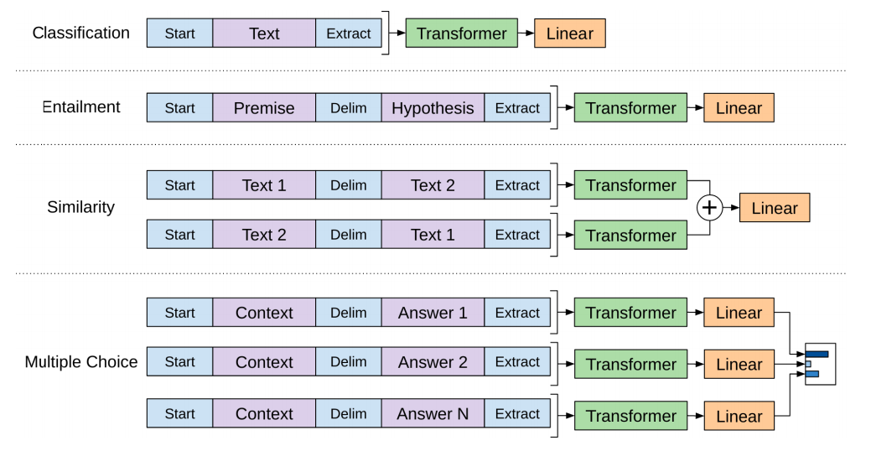
The Open AI Transformer (Finetuning)

Slide 21
Something’s not there?
ELMo’s bidirectional approach

Slide 22
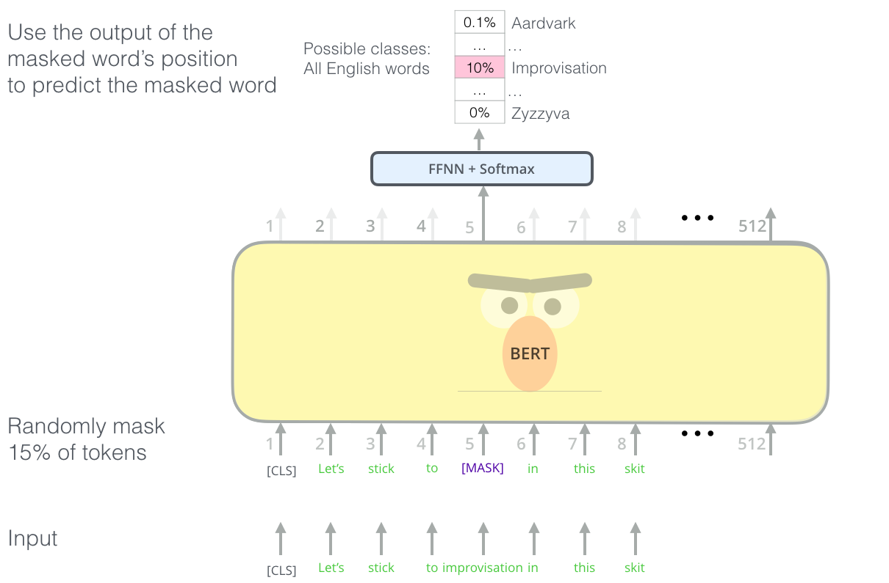
BERT (Architecture)

Slide 23
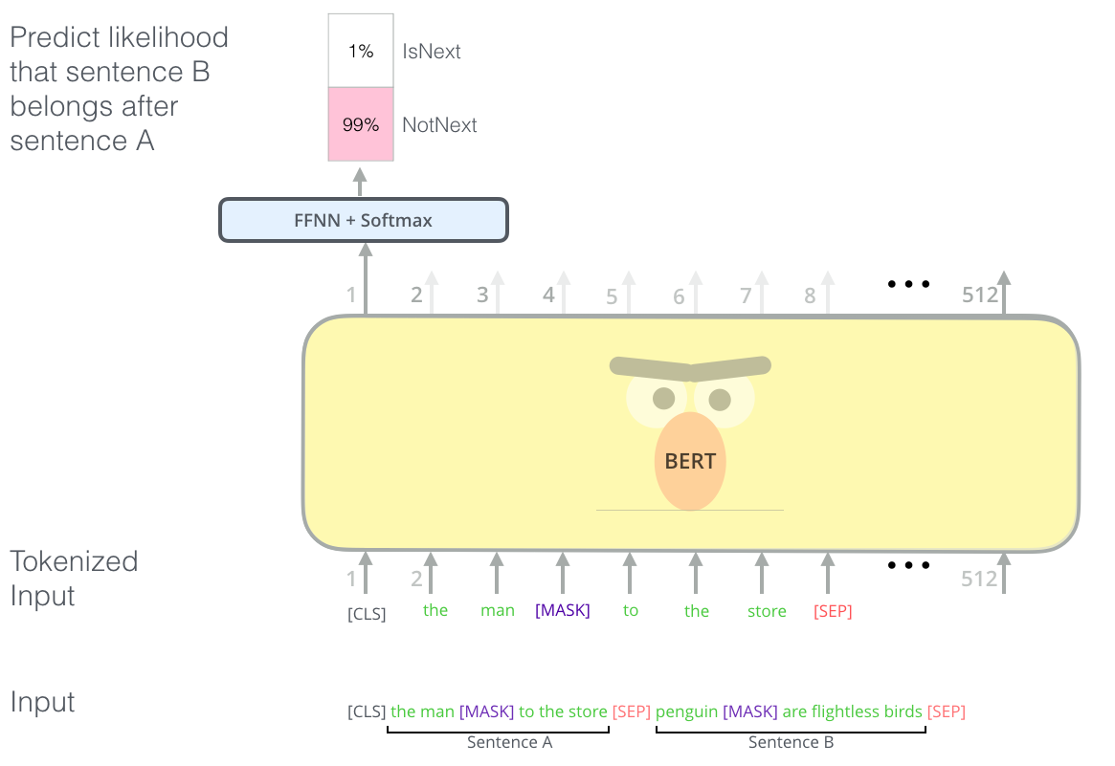
BERT (Architecture) [Two Tasks]

Slide 24
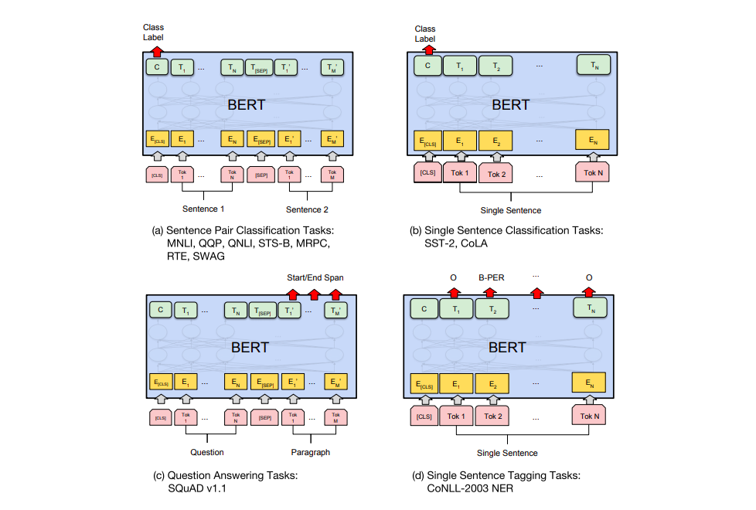
BERT (Architecture) [Use Case]

Slide 25
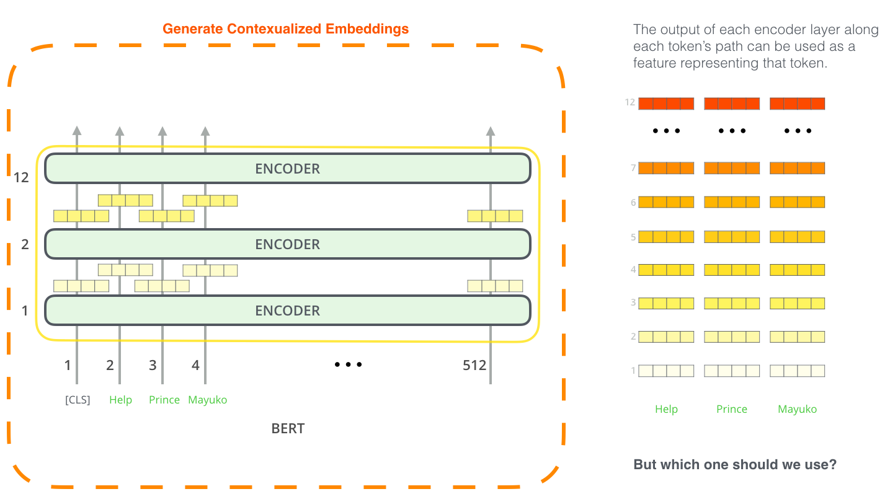
BERT (Architecture) [Feature Extraction]

Slide 26
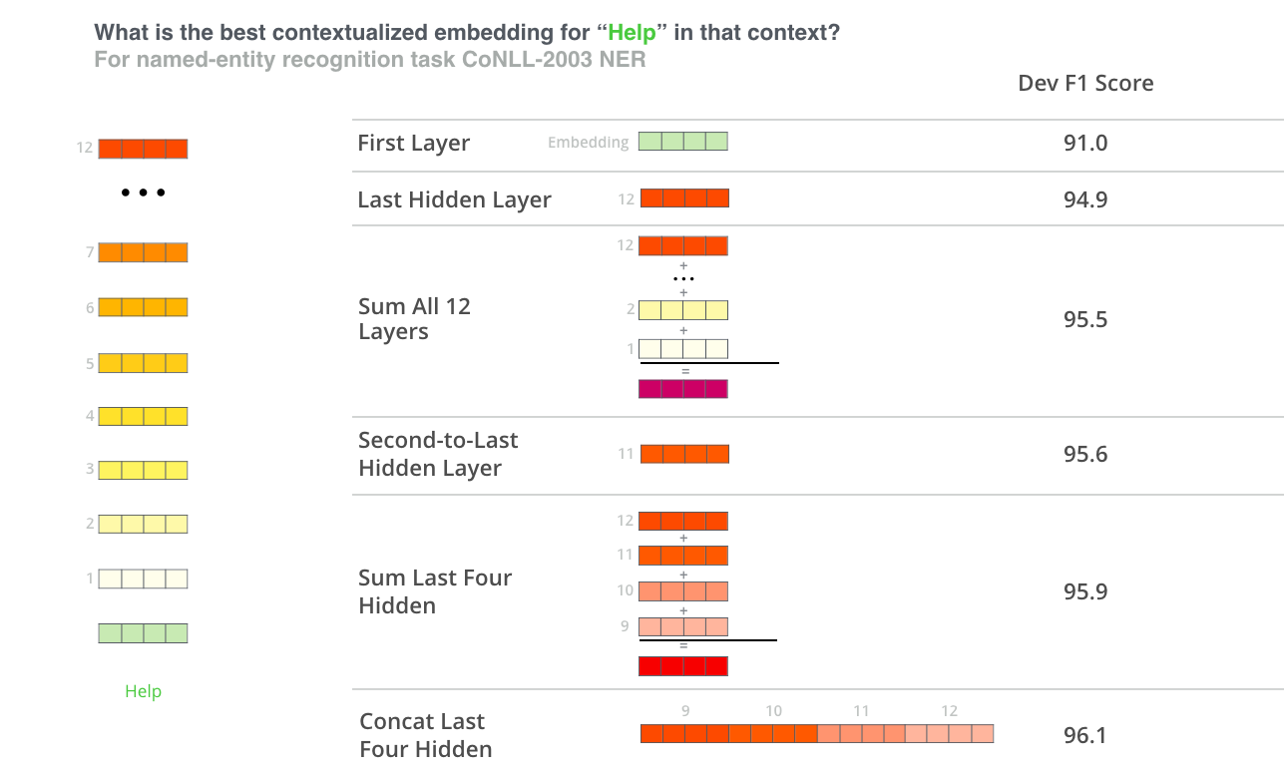
BERT (Architecture) [Feature Extraction]

Slide 27
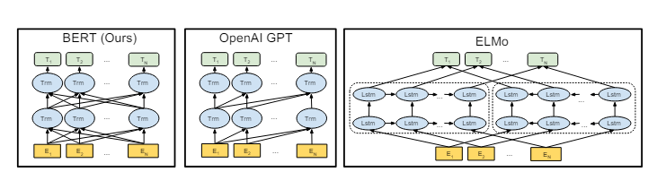
BERT Comparison

Slide 28
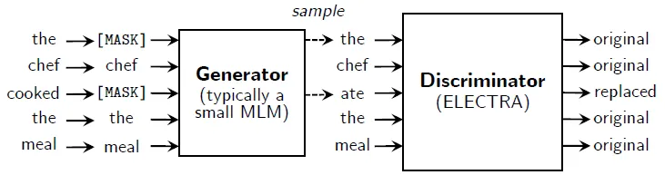
Electra

Slide 29
BERT
Bidirectional Encoder Representations from Transformers

